Slide 1


Slide 2


Slide 3


Slide 4

Content
General information 2
Previous EHC 3
Timeline for EHC 2025 4
Programme information 5
Promotional activities 7
Congress Centre Lisbon | plans 8
Catering concept 10
Benefits of the hybrid congress 11
Sponsoring options 12
Sponsoring 13
Exhibition 14
Programme | stream | sessions 16
Congress & printed materials 19
Mailing | marketing 20
Branding on-site 21
Branding on-site | digital options 23
Branding online 24
App 25
Miscellaneous 26
Venue branding 27
Contact 39
General terms and conditions 40
Don‘t miss this special
anniversary edition!

Slide 5


General information
Venue and date
hub27
9–12 December 2026
Congress co-chairs
Hosting society
EUROPEAN HEADACHE FEDERATION
The EHF was founded in 1992 to help improving the life of people affected by headache.
The non-profit organisation is working to improve awareness of headache disorders and to educate European key players on headache topics.
ehf-headache.com
Professor
Uwe Reuter
Berlin (Germany)
Professor
Mark Braschinsky
Tartu (Estonia)

Slide 6


Slide 7
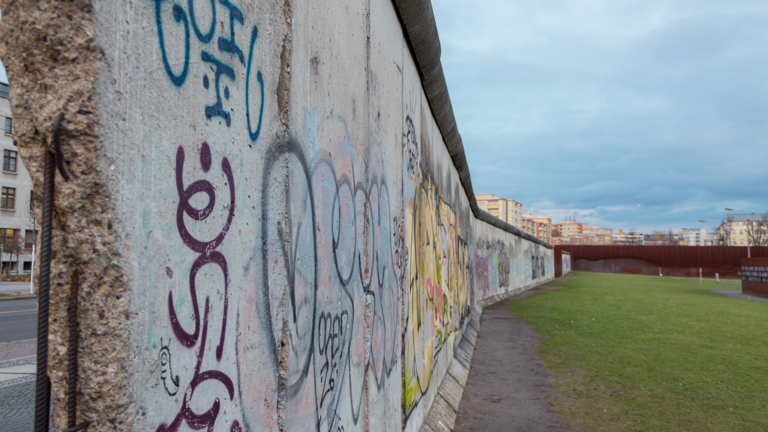

Slide 8


Slide 9


Slide 10


